Slide 1
Developing Apps for Office

Slide 2
What is an App for Office?
A Web page loaded inside an Office Application
Embedded inline or as task pane within documents, mails or appointments.
Works in both Office Applications and Office Web Applications
Office application extensions using Web technologies
HTML 5 and CSS used to construct user interface
JavaScript and jQuery used to add executable logic and event handlers
App can provided code to read/write content to/from Office documents
App can call Web services hosted over Internet or running within local network
Notes:
An App for Office can be seen as a Web page loaded inside an Office Application. In some cases it will appear embedded inline within the document. In other cases it might appear as a task pane or within a message in Outlook. Note that the architecture for Apps for Office has been designed to work in both Office Applications and Office Web Applications.
WEF and Apps for Office allow Office applications to be extended in such as way so that they can leverage Web technologies such as HTML 5 and CSS for rendering user interface as well as JavaScript and jQuery to add behavior. When you write the JavaScript code for an App for Office, you can call REST APIs such as those added to SharePoint 2013 to retrieve and update data from across network.

Slide 3



Designing Apps for Office - Shapes
Apps for Office come in three different shapes
Task Pane App (only shape supported by Microsoft Word)
Content App
Mail App
Word Application
Excel Application
Outlook Application
Document
Task Pane App
Document
Inbox
Selected Message
Reply | Reply All | Forward
app
Mail App
Content App
Message Body
Notes:
When you begin to design an app, you must pick one of the three different shapes. You can create a document-based app as either a Task Pane App or a Content App. Alternatively, you can create a Mail App that targets Outlook and Outlook OWA.

Slide 4
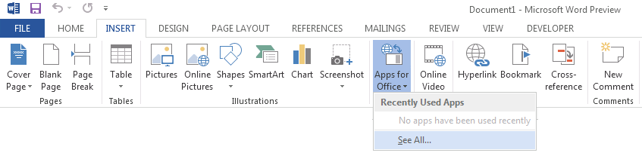
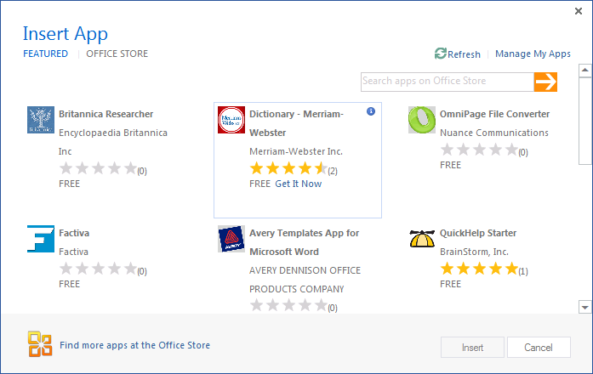
Adding a App for Office using the Insertion UI
Apps for Office insertion UI located in Ribbon inside Insert Tab
Dialog allows you to add and start App for Office app
Notes:
Office 2013 applications provide users with the ability to discover apps and insert them. In Word and Excel, this support is included in the Ribbon inside the Insert Tab. As you can see from the slide above, the drop-down menu for inserting apps has a caption of "Agaves" in the beta cycle and will be updated to say "Apps" before RTM.
When you drop down the Apps menu from the ribbon, you can see recently selected apps. If you click "Select All", you will be prompted with a dialog that allows you to look in various app directories. Once you find an app you want to use, you can click the Start button to insert the app into the current document and start it up. After this, you can save the current document which will then include the app.

Slide 5
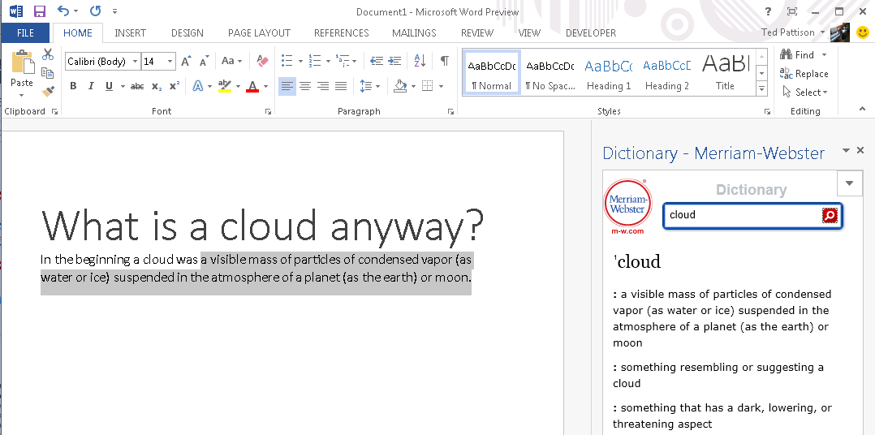
Task Pane App User Experience
Familiar User Experience
Leverages familiar Office UI paradigm
Reference Information
Ideal for providing reference information associated with document.
Notes:
One reason to create a task pane app is that it provides Office users with a familiar user experience. For example Microsoft Word and Microsoft Excel have exposed many of its internal features using task panes so task pane apps provides a familiar Office UI paradigm.
Task pane apps are ideal for providing users with reference information. For example, a task pane app can perform Internet searches or lockups and provide reference information that can be inserted back into the current document.
This slide contains a screenshot showing the app after it has been inserted in a document. In Microsoft Word 2013. Different apps provide different user experiences. This app which is available for free on the Office Store allows the user to leverage the Marriam-Webster online dictionary lookup service to look up words and terms right from within Microsoft Word.

Slide 6
Developing Apps for Word

Slide 7
Visual Studio Experience
Create new App for Office project
Create/design user interface for Web page
Enhance Web page with CSS and JavaScript
Set project properties in manifest
Run!
Notes:
This slide is pretty self-explanatory and demonstrates just how easy it is to create and test your first App for Office using Visual Studio 2012. First, you will create a new project using one of the new project templates in Visual Studio 2012. Next, you will create the user interface for the app using HTML5 and CSS. After that, you add behavior to the app by writing JavaScript. Finally, you will update the XML file which serves as the app manifest. After that, you can press the {F5} key to test and debug your app.

Slide 8
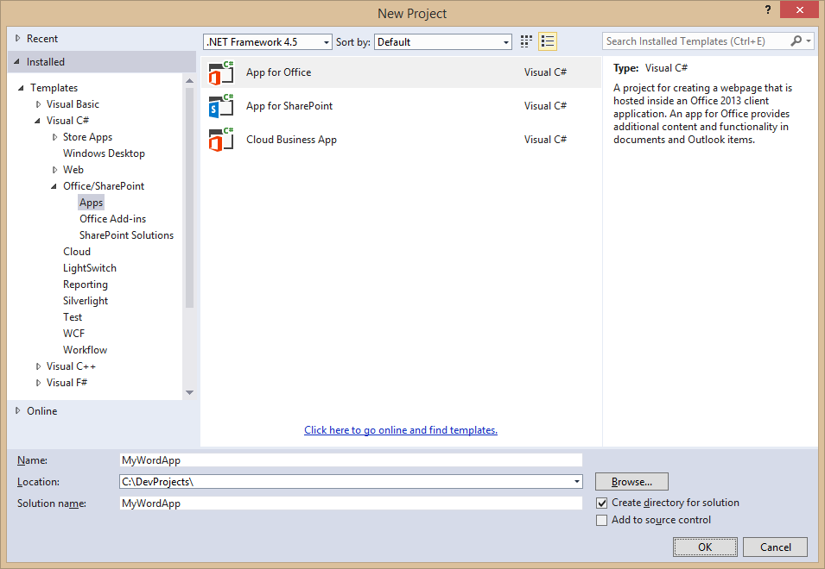
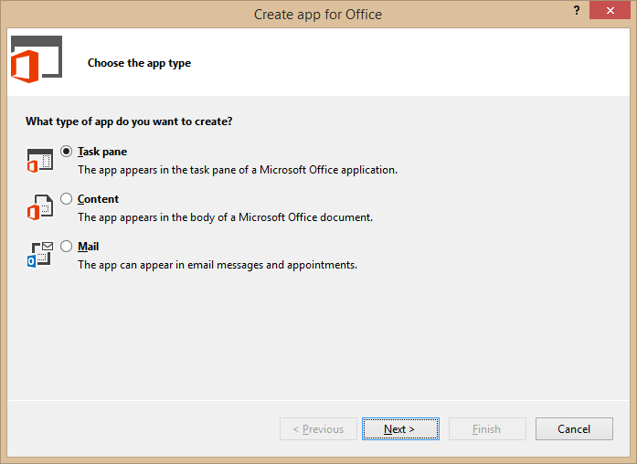
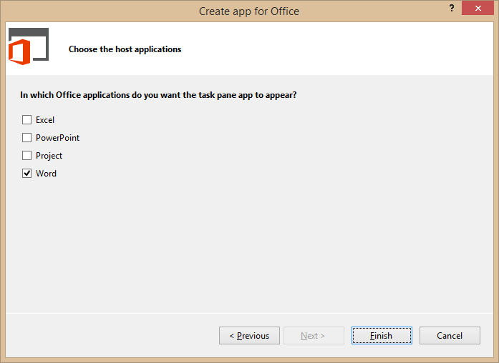
Create New App for Office Project
Create project based on App for Office 2013 project template
Dialogs appear and prompts you for specifics about the app
You must choose (1) the app shape and (2) which Office application are to be supported
Notes:
Visual Studio has a new project template for Apps for Office. These project types gives you a starter project with a web page and manifest.

